Slide 1
Naïve Bayes’ Classifier

Slide 2
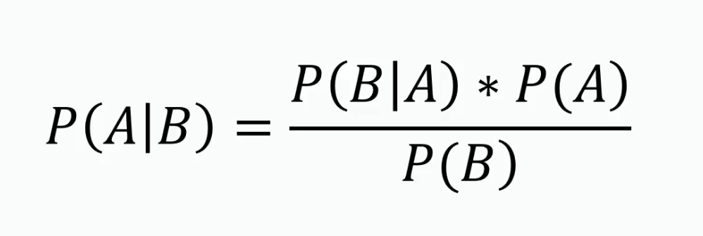
Bayes’ Theorem
Bayes’ theorem is a way to figure out conditional probability. Conditional probability is the probability of an event happening, given that it has some relationship to one or more other events. For example, your probability of getting a parking space is connected to the time of day you park, where you park, and what conventions are going on at any time. Bayes’ theorem is slightly more nuanced. In a nutshell, it gives you the actual probability of an event given information about tests.

Slide 3
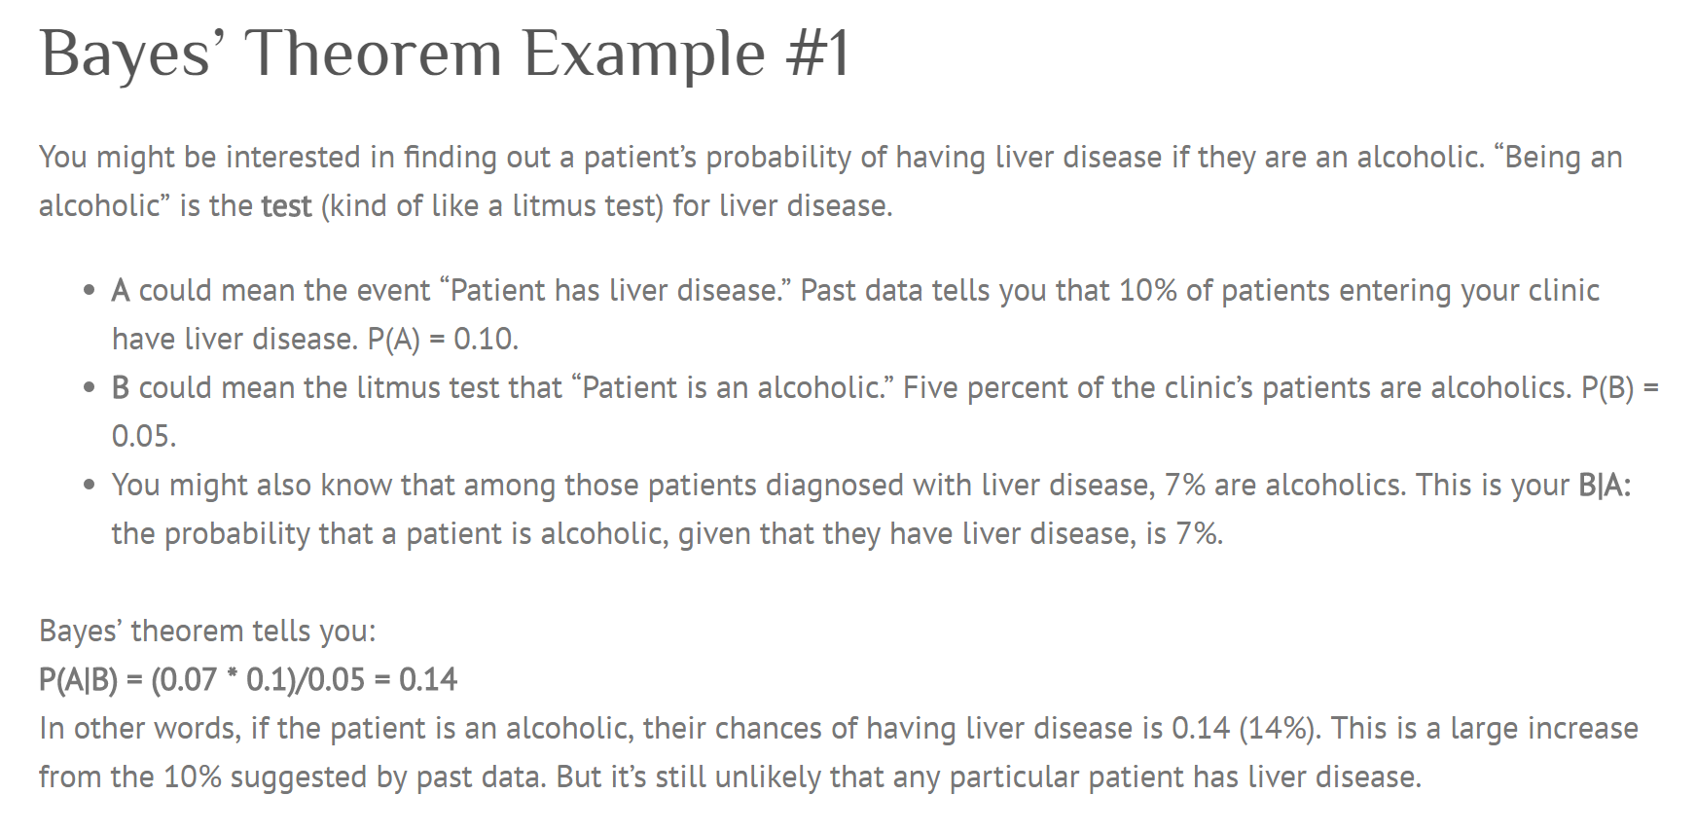

Slide 4
Example Problem
Given a dataset of people and their mode of commute, we will try to figure out the mode of commute of another person.
Every person in the dataset has attributes – Age and Salary.
Our goal is to analyse these attributes and determine the mode of commute for someone outside this group of people.

Slide 5
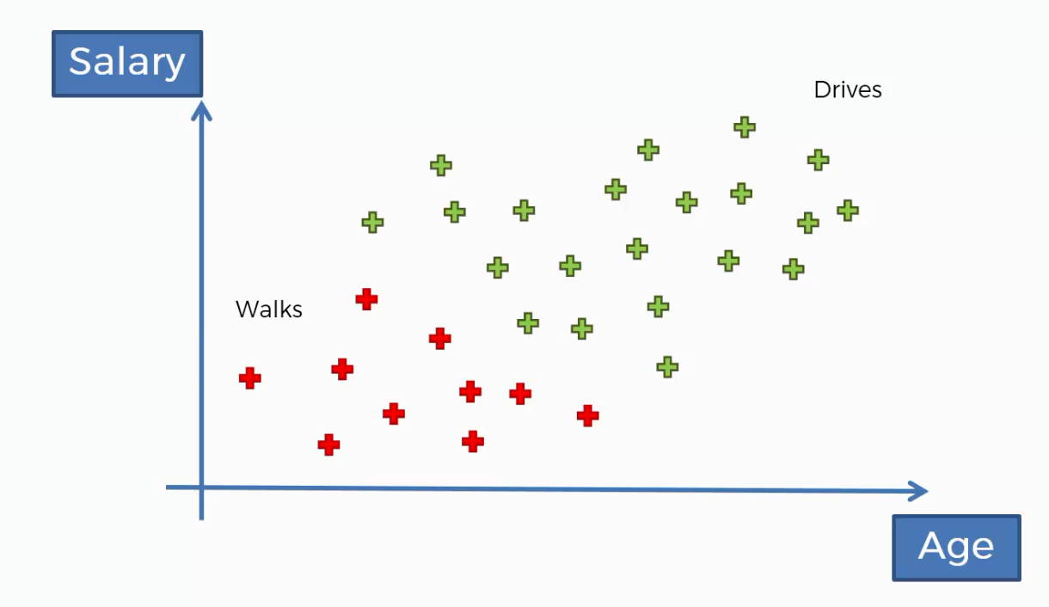

Slide 6
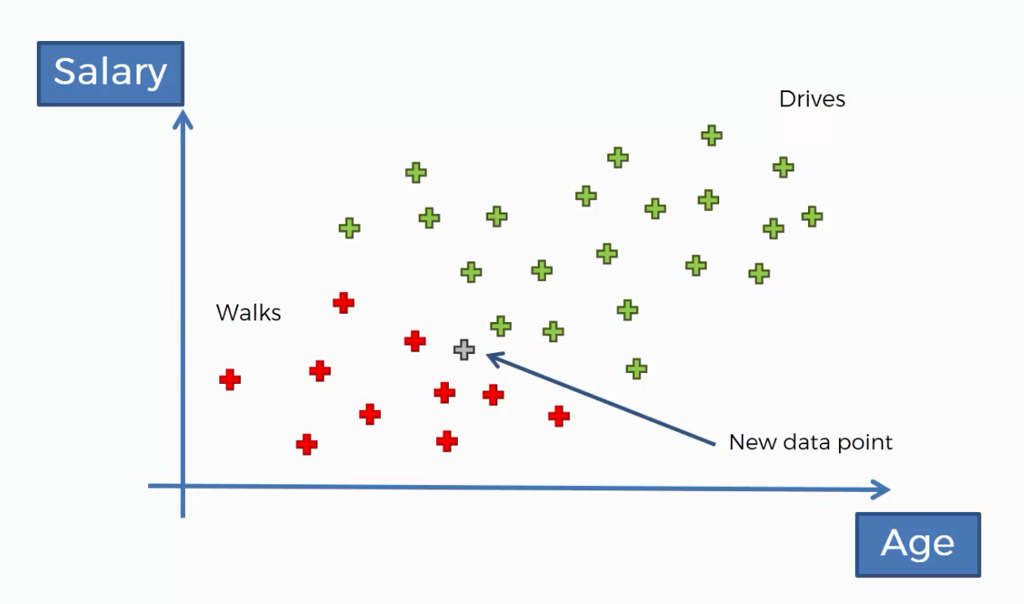

Slide 7
Steps to solving this example problem:

Slide 8
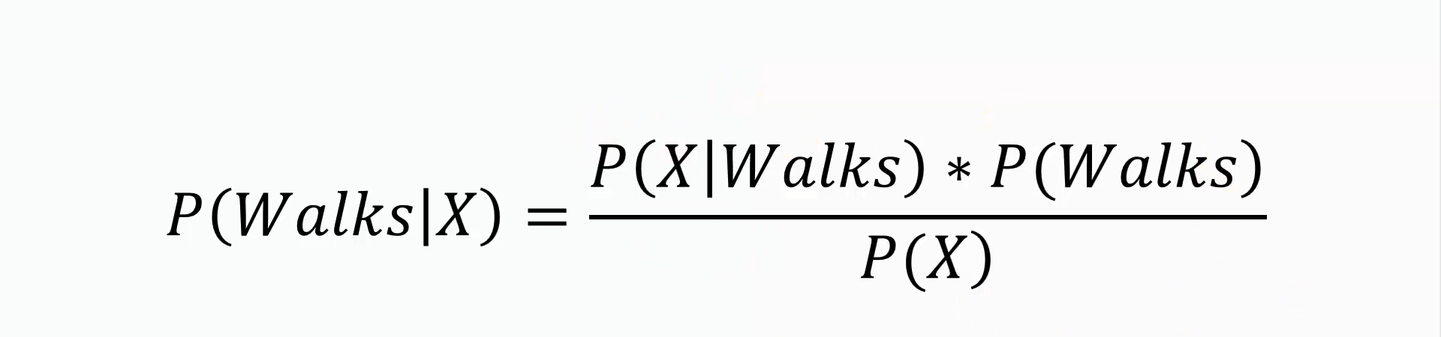
Step 1

Slide 9
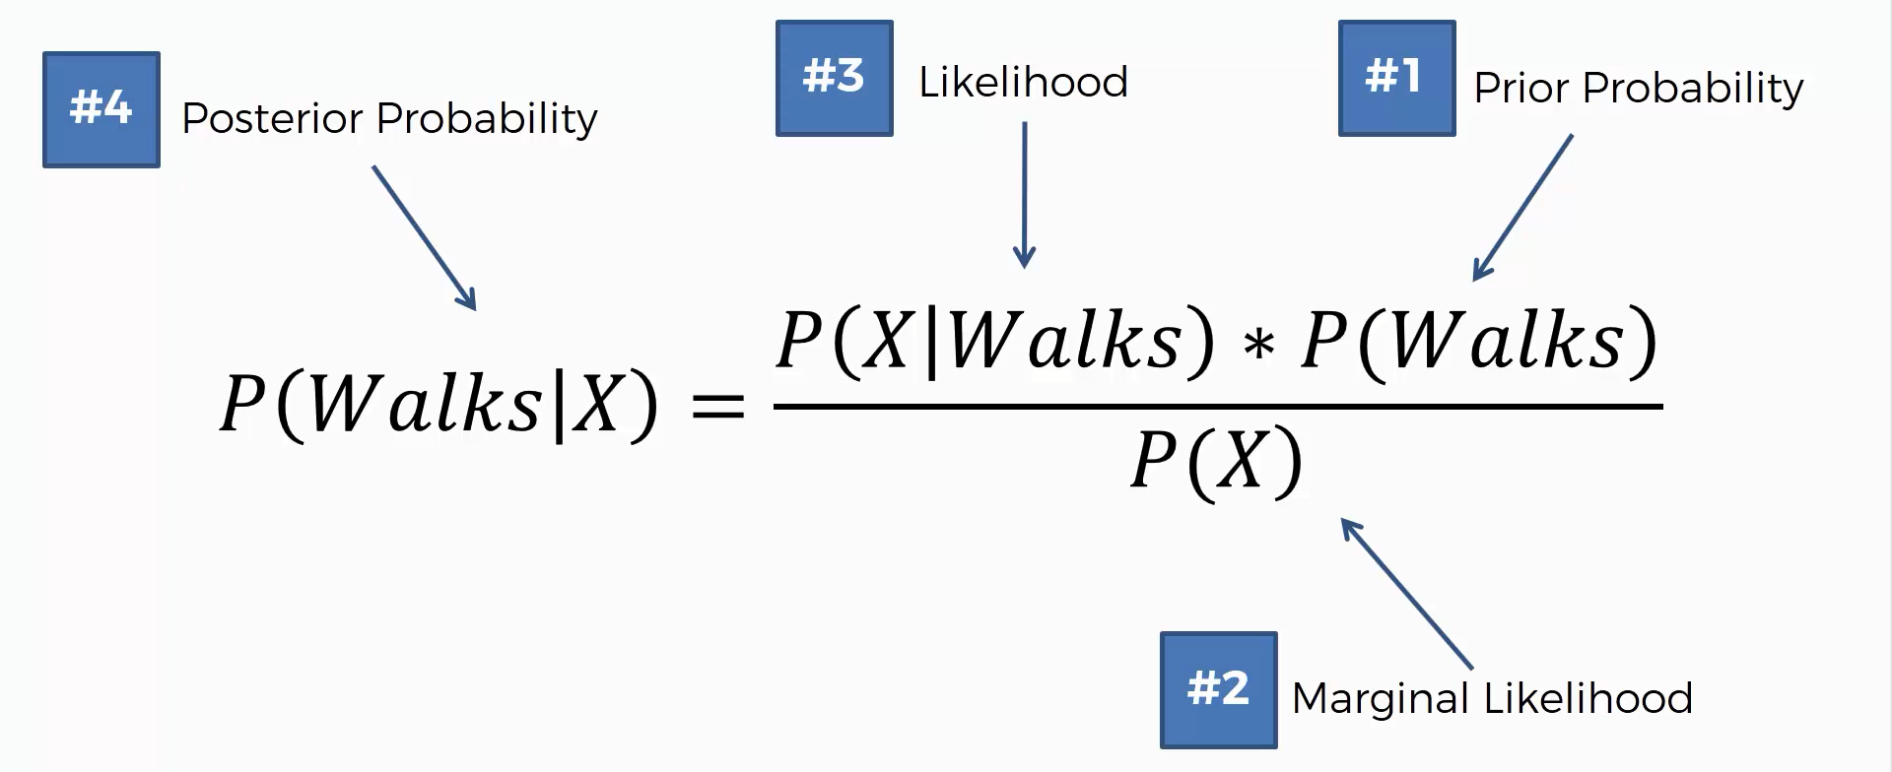

Slide 10
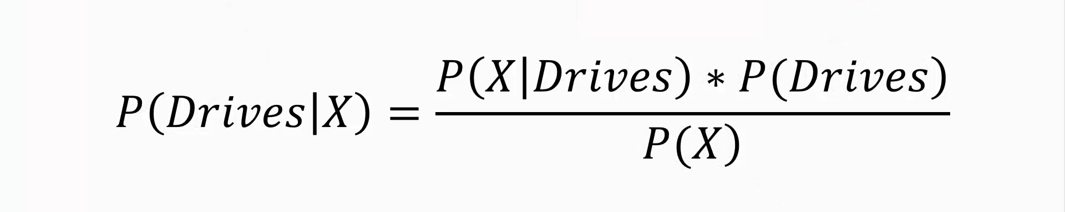
Step 2

Slide 11
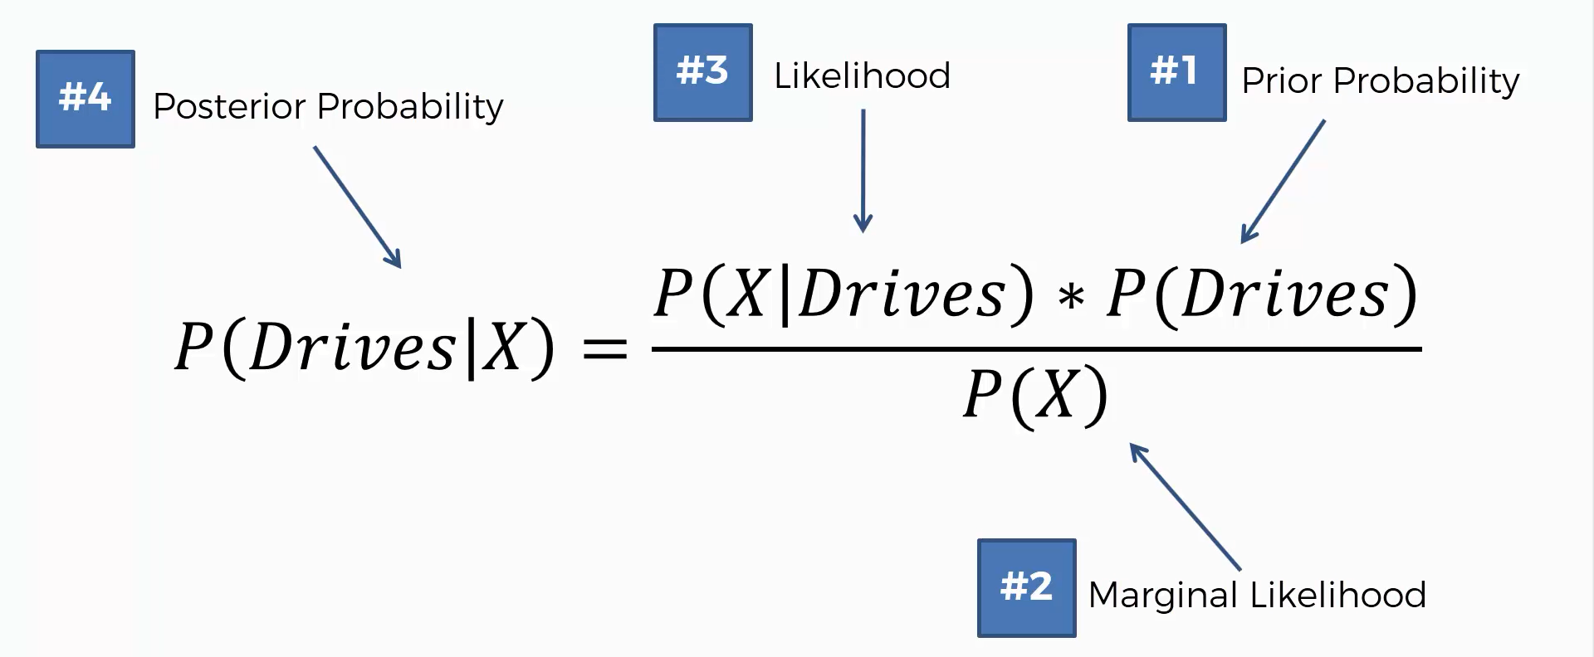

Slide 12
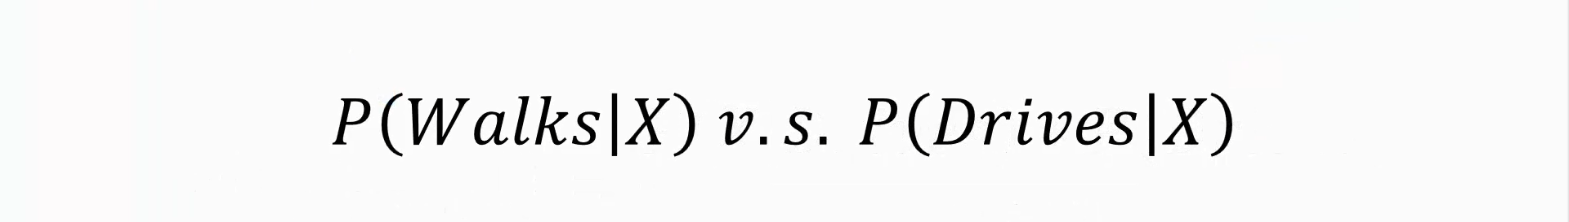
Step 3

Slide 13
Lets find the Estimation using a Naïve Bayes Classifier

Slide 14
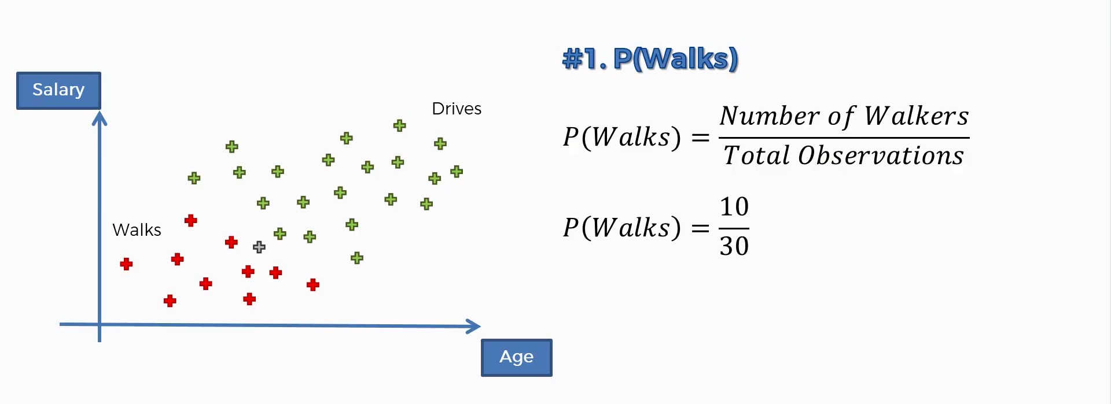

Slide 15
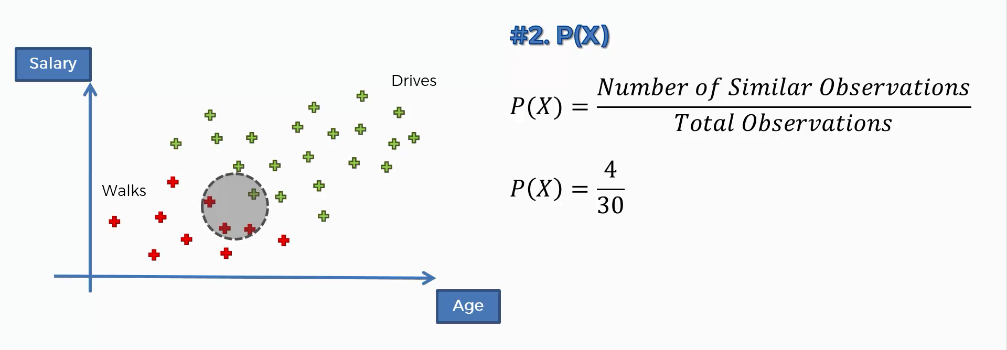

Slide 16
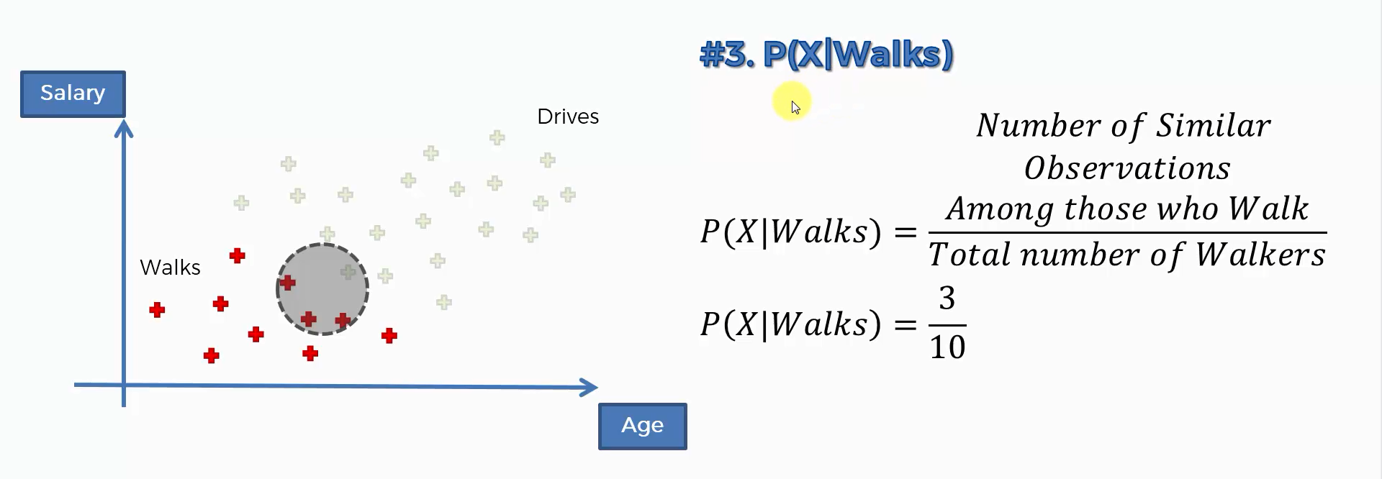

Slide 17
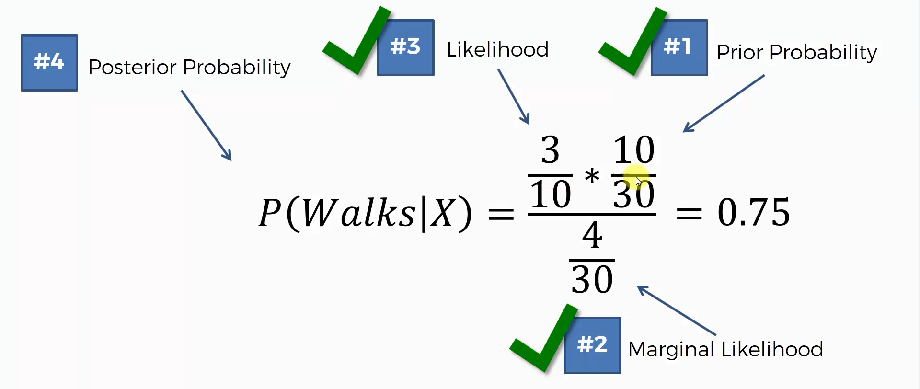

Slide 18
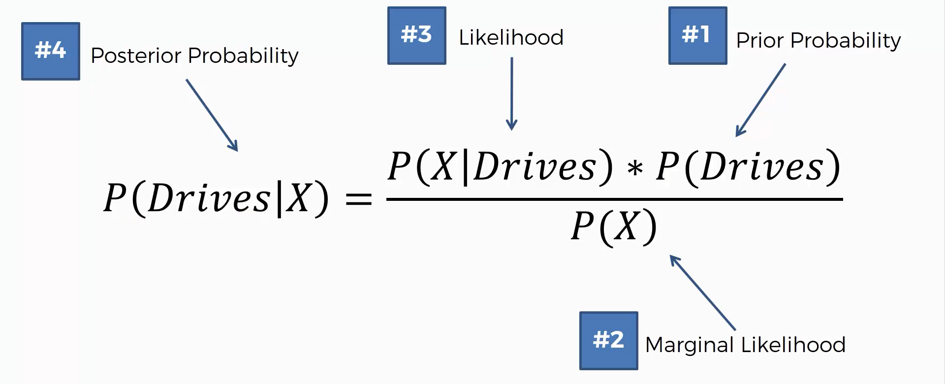

Slide 19
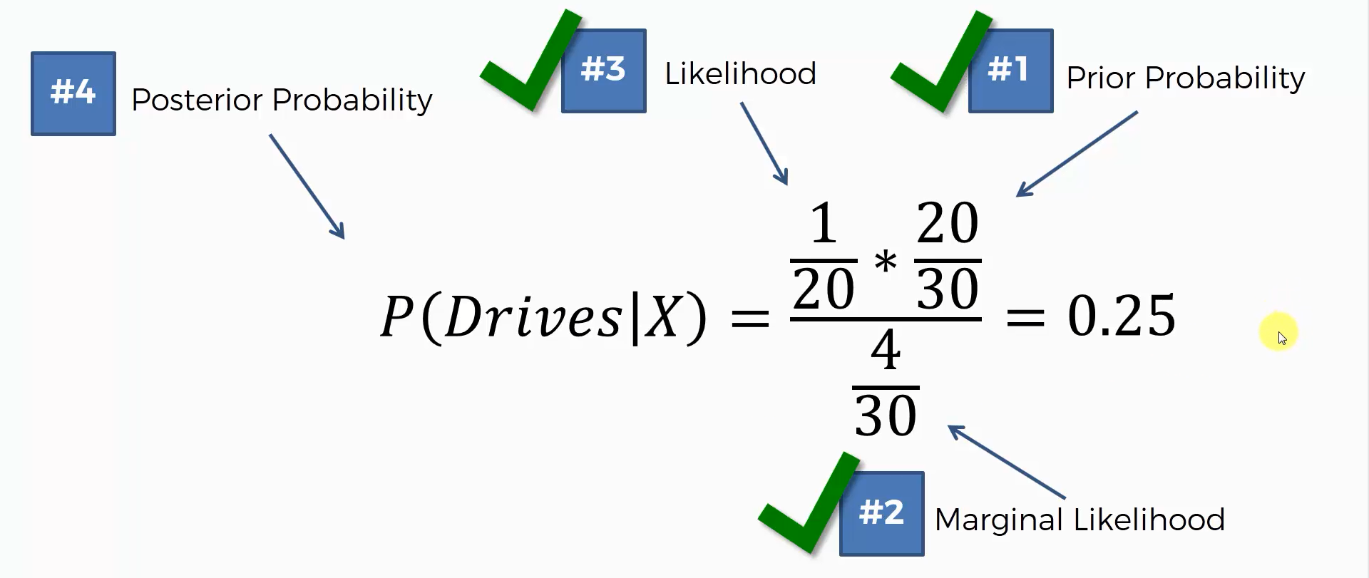

Slide 20
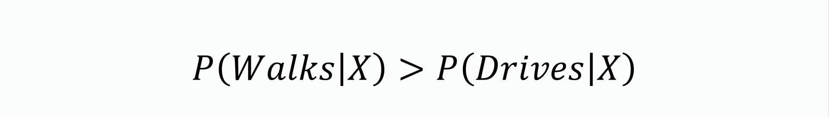

Slide 21
